Slide 1
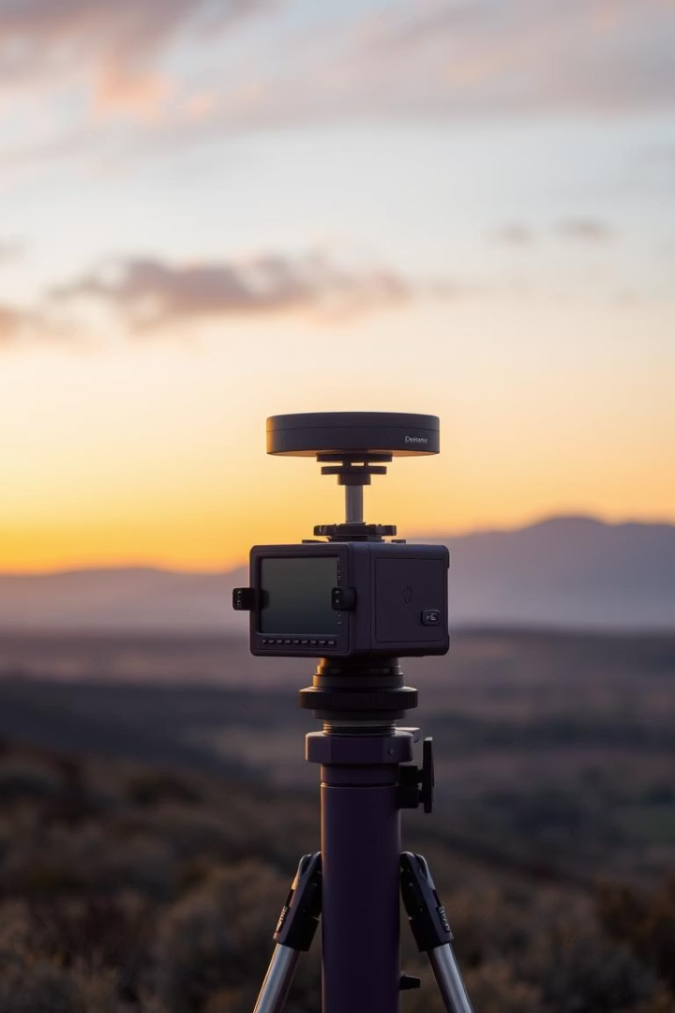

Rainfall Prediction Using Machine Learning
Predicting rainfall using machine learning models. Project utilizes historical weather data. Achieved 85% accuracy using XGBoost.
by Mohammed Faraan

Slide 2

Abstract
ML-Based Rainfall Prediction
Models
Historical weather data used for training.
Logistic Regression, XGBoost, SVC.
High Accuracy
Tools
XGBoost achieved 85% accuracy.
Python, Scikit-learn, XGBoost, Streamlit.

Slide 3
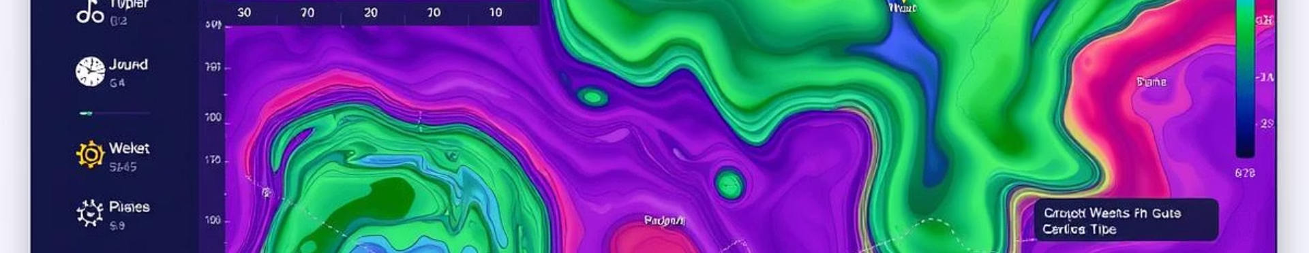
Existing System
Numerical Simulations
Computationally Expensive
Traditional forecasting methods.
High resource requirements.
Less Accurate
Not Adaptive
Local, short-term forecasts inaccurate.
Struggles with sudden weather changes.

Slide 4
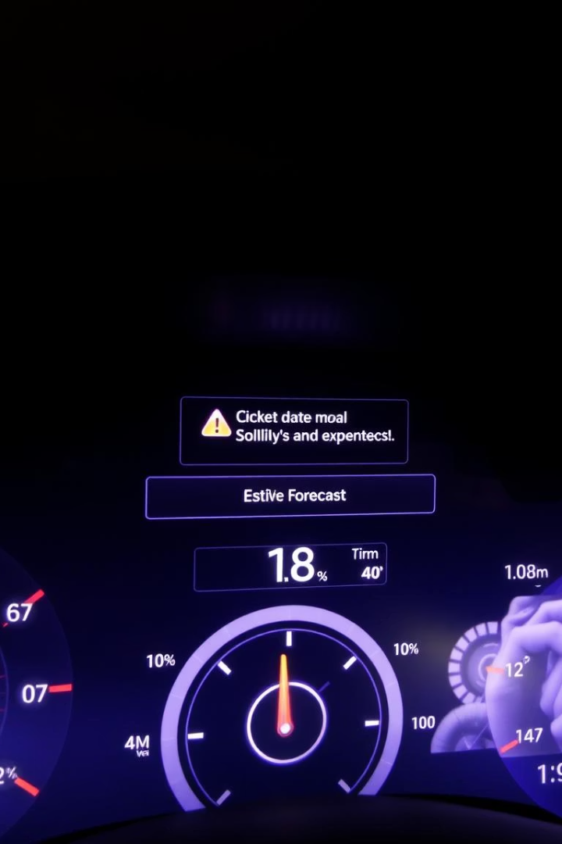



Drawbacks of Existing System
High Resource Usage
Limited Accuracy
Data Handling Issues
Computational demands are significant.
Localized predictions are not precise.
Struggles with large/unstructured data.

Slide 5



Proposed System
1
Prediction
2
Model Training
3
Data Preprocessing
Data preprocessing, model training, and prediction. Streamlit web interface for real-time predictions.

Slide 6





System Architecture
Data Input
Preprocessing
ML Models
Prediction
Web UI

Slide 7
System Specifications
Hardware
Software
Processor: Intel i5+
Python
RAM: 8 GB
Jupyter/VS Code
Storage: 256 GB SSD
Pandas, Sklearn
XGBoost, Streamlit

Slide 8




UML Diagram
User
1
System
Actor
2
Actor
Receive Prediction
4
Input data
3
Action
Action

Slide 9
Modules
1
Data Preprocessing
2
Feature Selection
3
Model Training
4
Prediction Module
5
Web Interface

Slide 10
Working Procedure
Load/Clean Data
1
2
Split Data
Train Models
3
4
Evaluate Models
Deploy Model
5
6
User Input/Prediction

